Slide 1
ChatGPT Q&A Platform
Team TwoSum
Yucheng Wang, Yang Li, Chenlei Luo, Chenchen Zhang

Slide 2
Our Team Layout
Yucheng Wang
1
1. Develop the chatGPT interface.
2. Create ChatGPTManager to control the data delivery.
1. Implement unit test for ChatGPTChat and windows
2. Implement integration test.
3. Deploy the platform on Render
Yang Li
2
Chenlei Luo
3
1. Front-end UI: login pages
2. Contribute to the design of webpages.
Chenchen Zhang
4
1. Design front end calculator page
2. Contribute to design of chat window

Slide 3
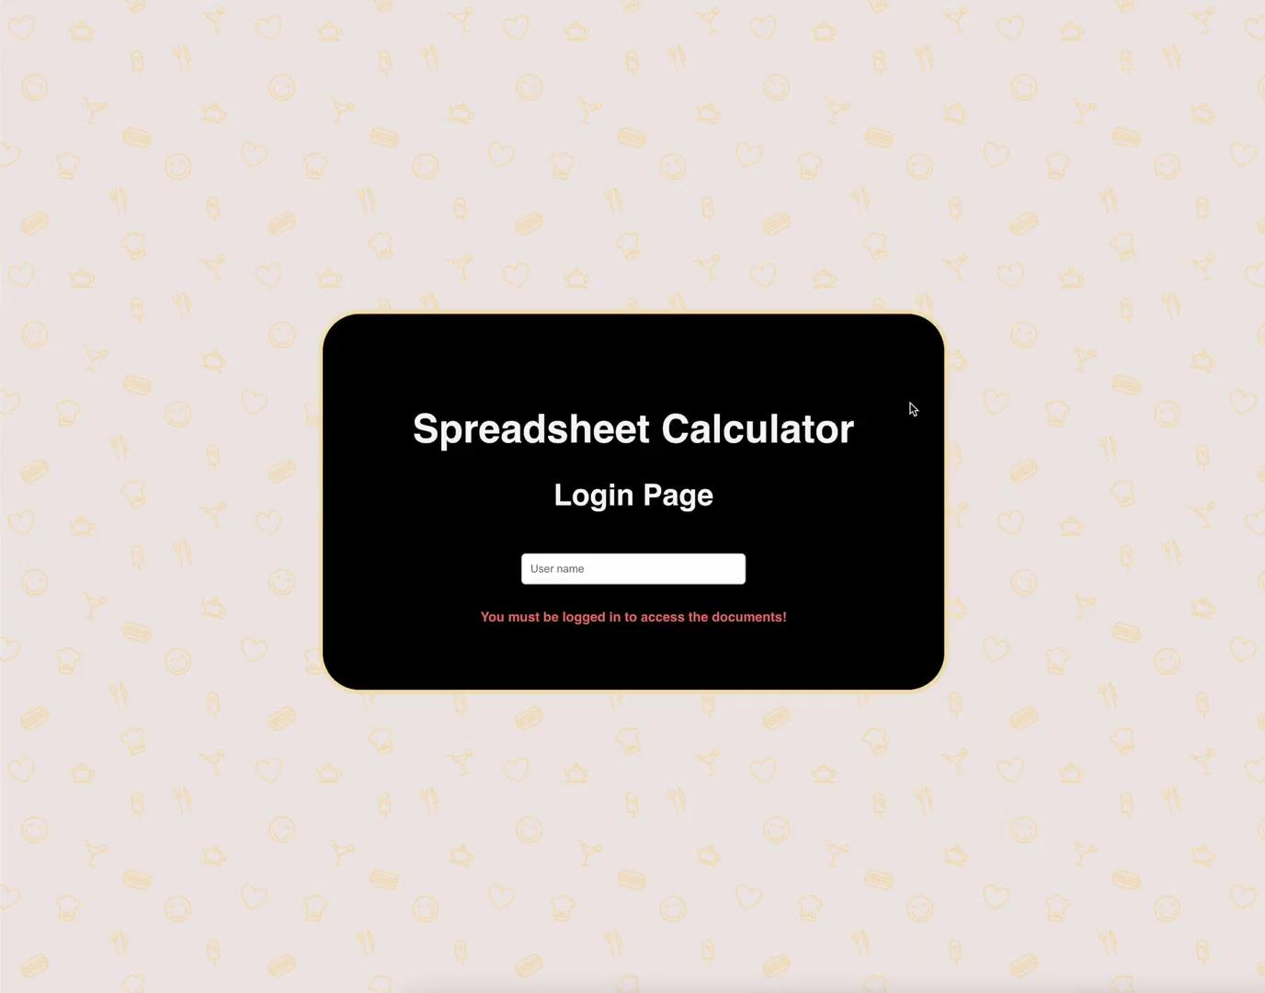
Demo

Slide 4
Feature overview

Slide 5
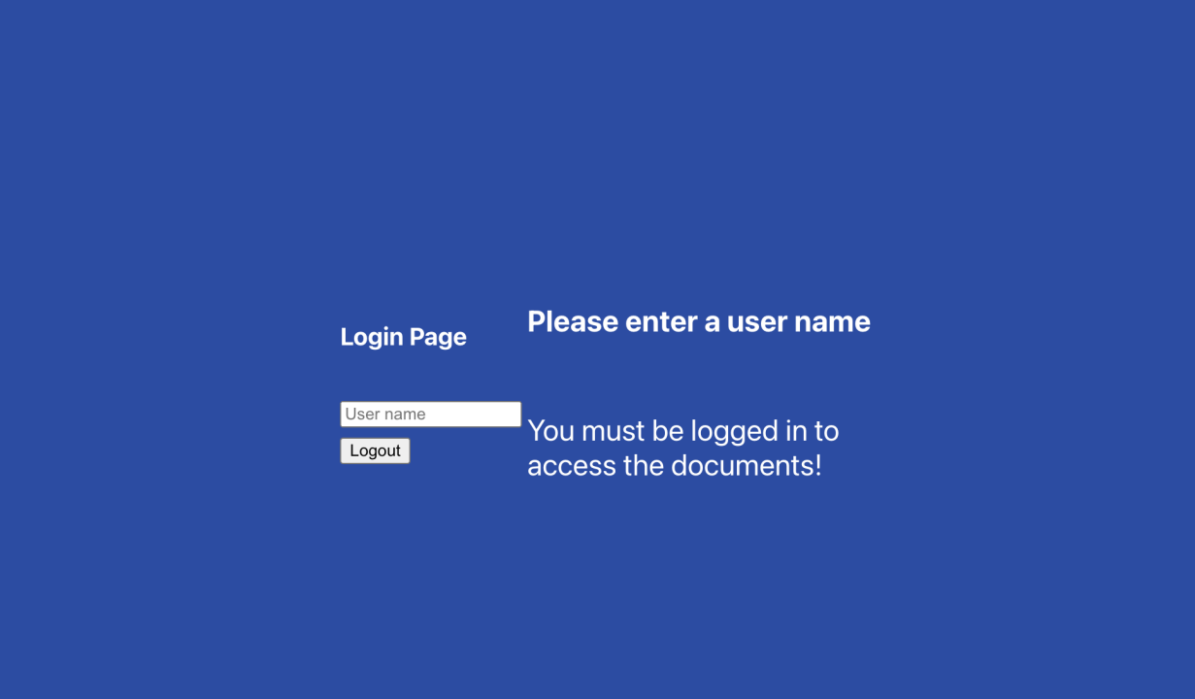

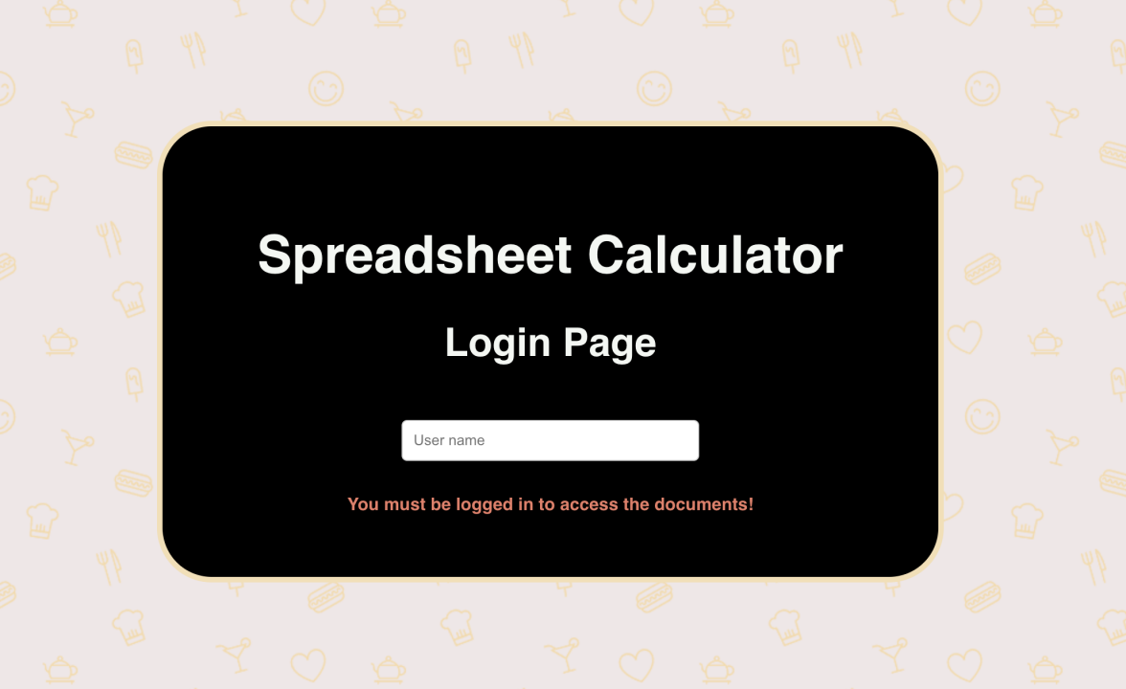
Front-end UI - Login Page
Changed Login page layout-column
Added a login background window
Added app name and changed the font-size of texts
Removed unnecessary logout button
Changed user name warning to popup warning message
Notes:
We hide the chat windows from our main page, make the user interface more concise

Slide 6
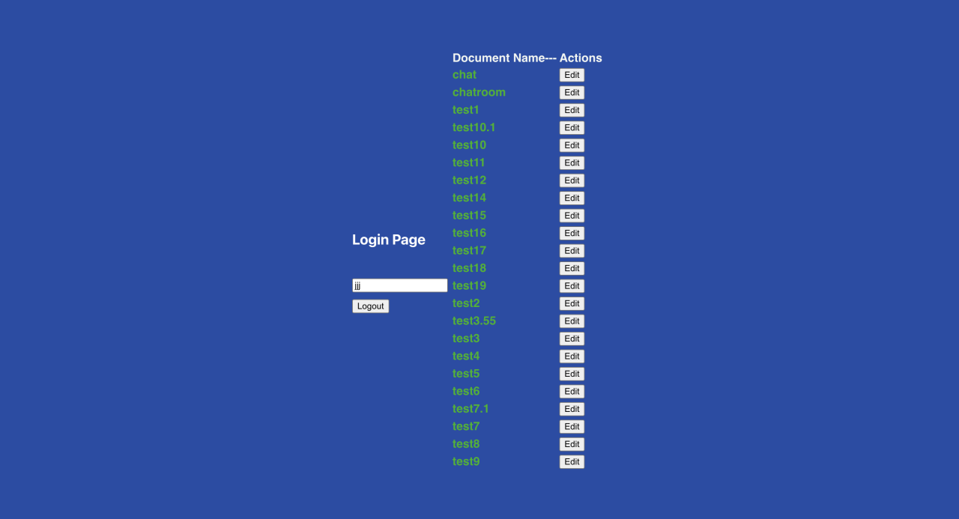
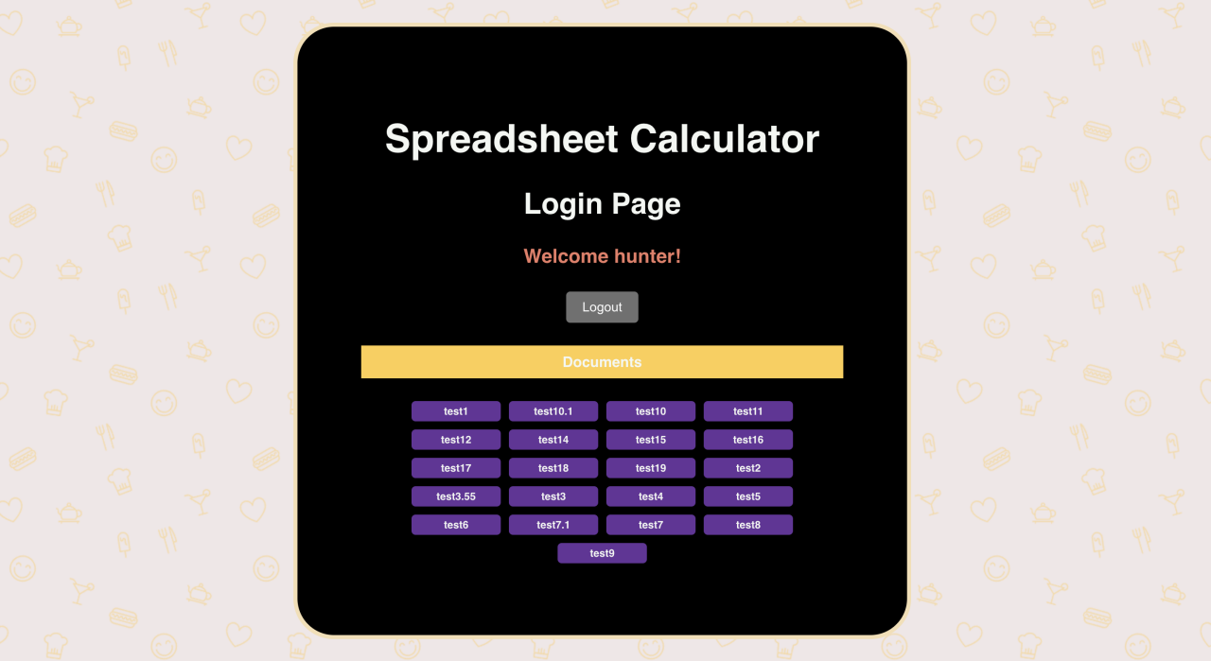
Front-end UI - Login Page
Changed Login page layout-column
Added customized welcome message
Removed username input component
Combined edit function and document name together
The documents are closely packed together
Added hover effects on the documents and logout button
Notes:
We hide the chat windows from our main page, make the user interface more concise

Slide 7
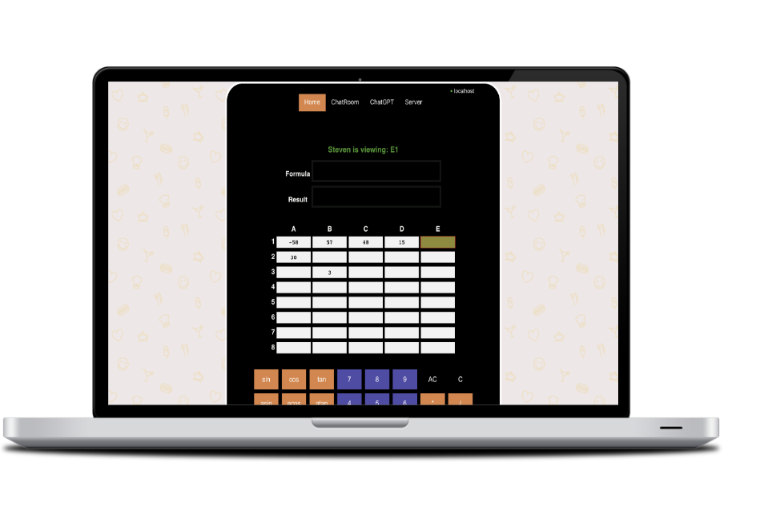
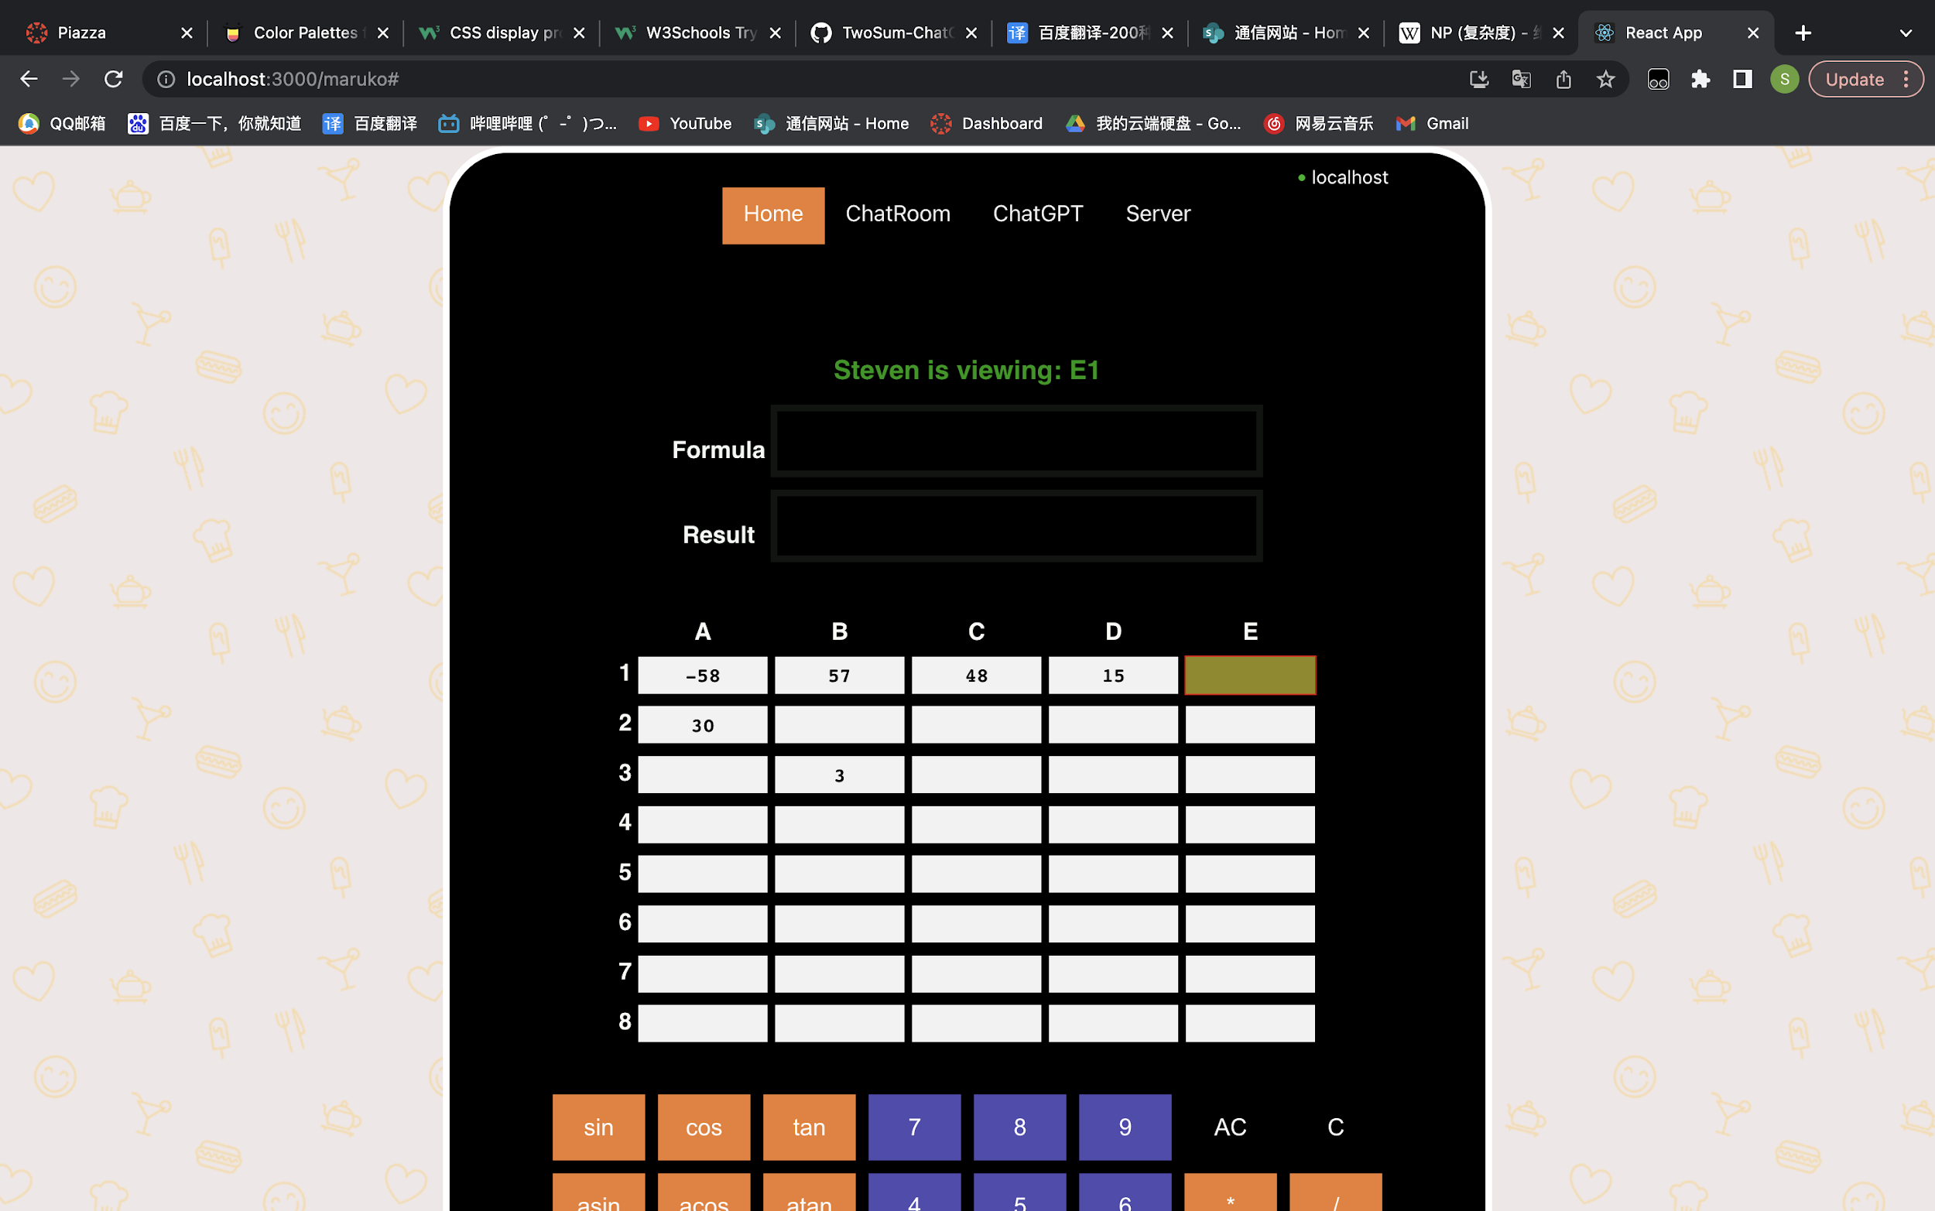
Code Review - Calculator UI Design
Notes:
We hide the chat windows from our main page, make the user interface more concise

Slide 8

New Navigation Bar
By implementing navigation bar, we can hide unnecessary features. Make our calculator more concise and elegant
Notes:
We hide our feature in the nav bar. When user click the button, the chat window will pop up.
We also design a dropdown box for server selection

Slide 9
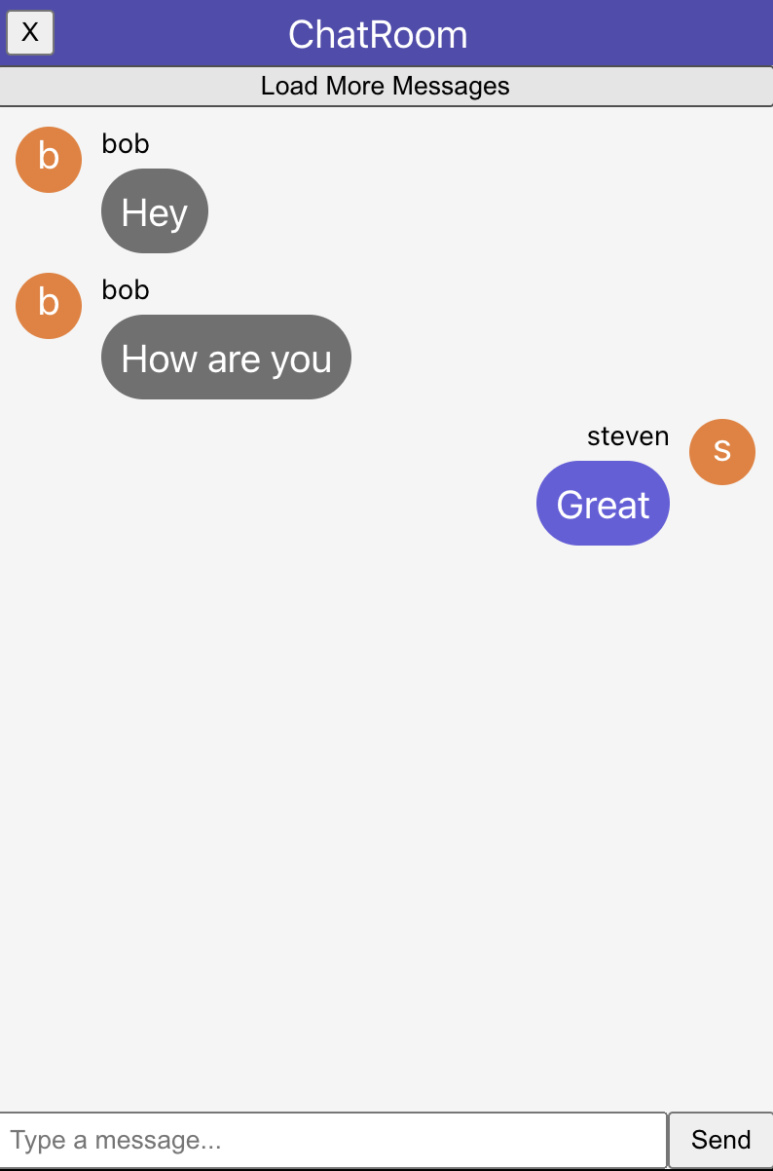
Better Chatroom
Redesign chat window to improve usability and personalization.
user avatar
message bubble
user name
Notes:
We design user avatar for each user. Different message bubble to distinct our messages from others. Add user name upon the bubble so that users can know who they are chatting with

Slide 10
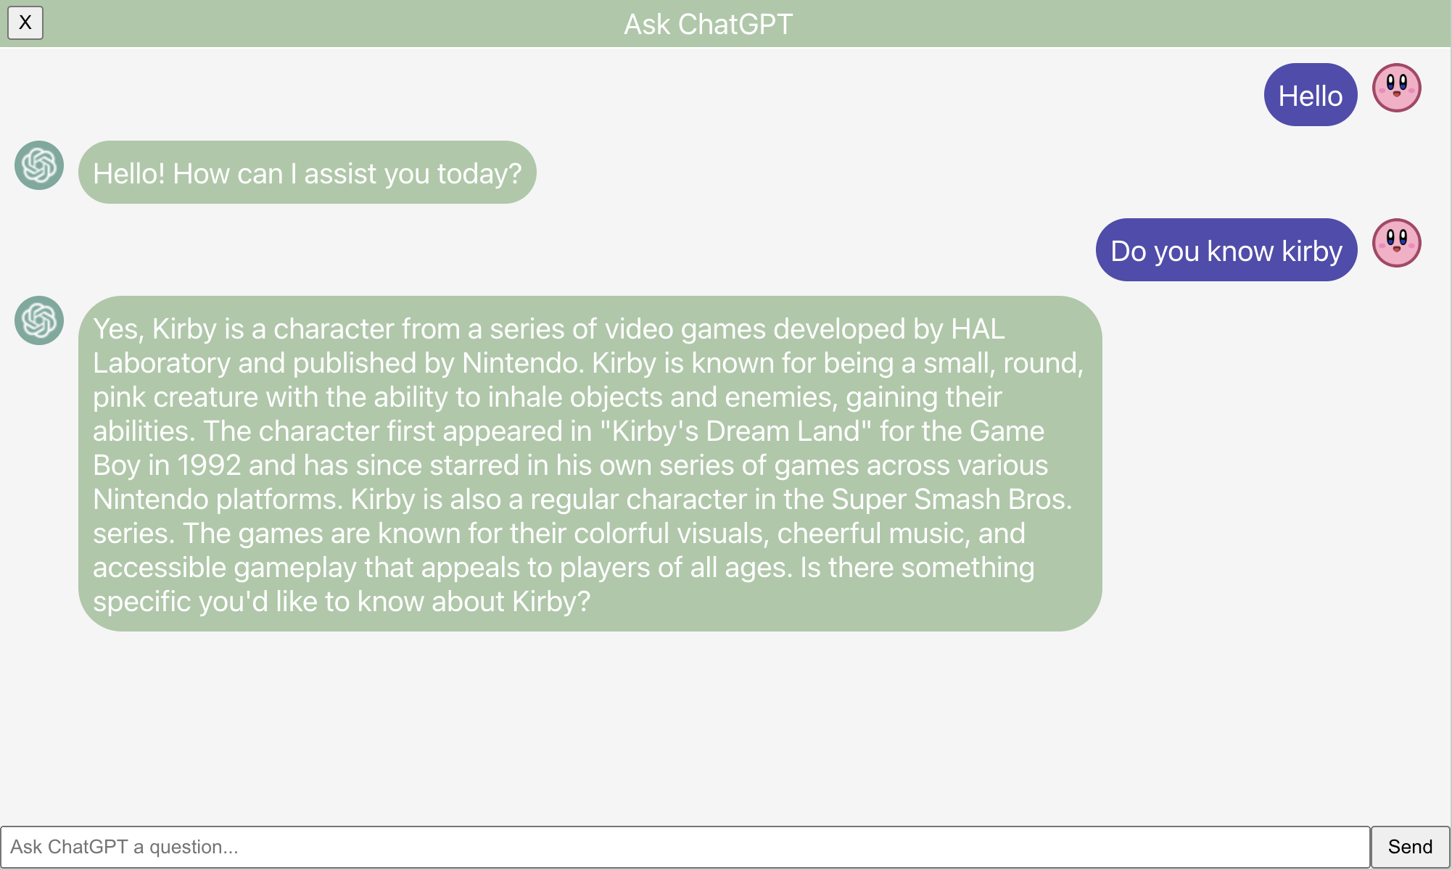
ChatGPT Interaction
Notes:
We design a bigger chat window for chatgpt to contain more information.
Besides, when chatting with chatgpt. other users can also see the samecontent, which allows knowledge sharing

Slide 11
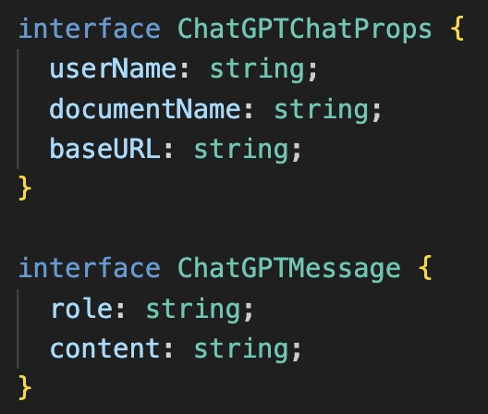
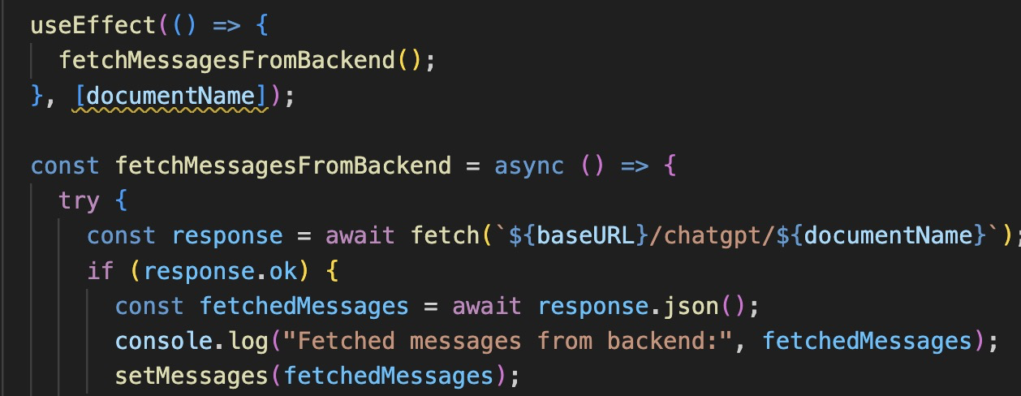
Code Review - backend
New interface:
Fetch Data from backend
Notes:
We design a bigger chat window for chatgpt to contain more information.
Besides, when chatting with chatgpt. other users can also see the samecontent, which allows knowledge sharing

Slide 12
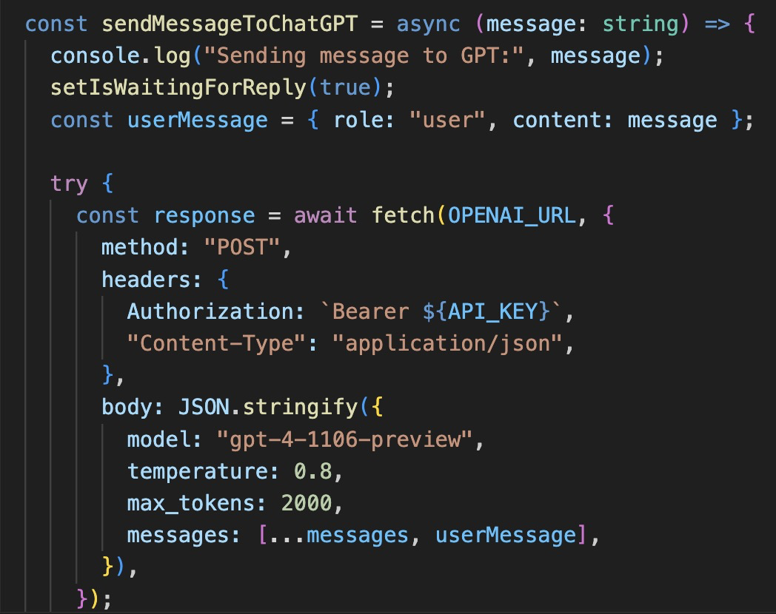
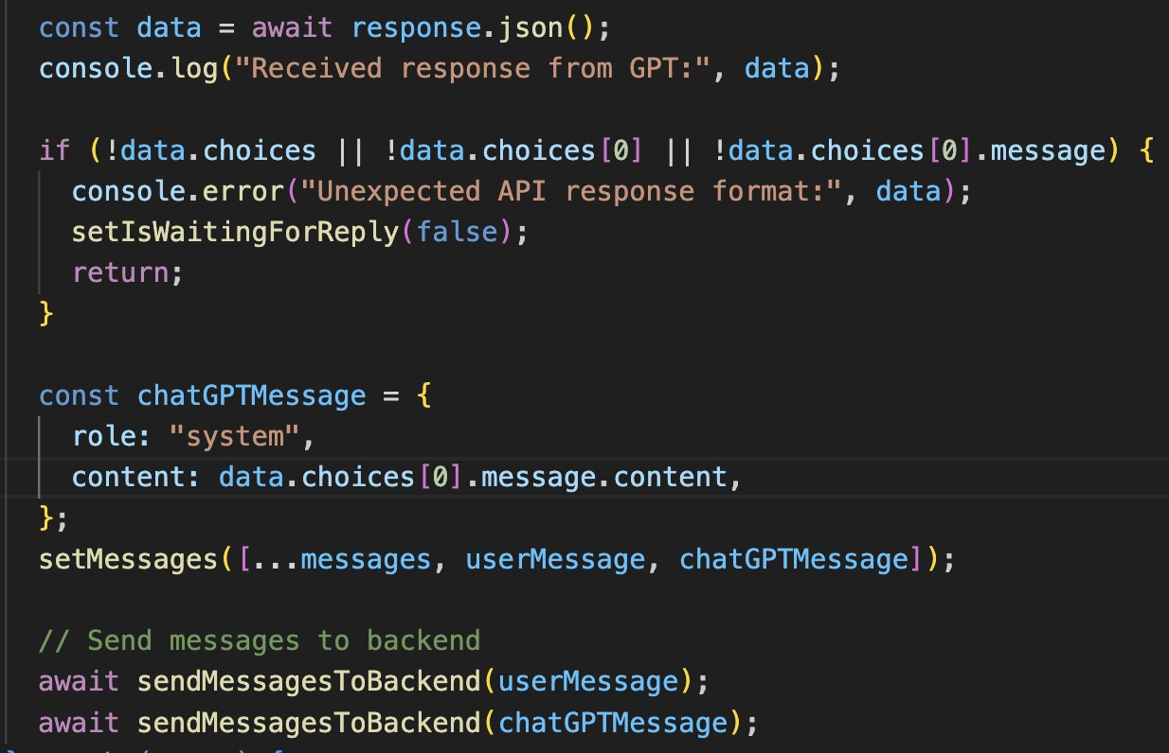
Code Review - backend
Post Data to API -Part1
Post Data to API -Part2
Notes:
We design a bigger chat window for chatgpt to contain more information.
Besides, when chatting with chatgpt. other users can also see the samecontent, which allows knowledge sharing

Slide 13
Technologies Explored
1.A separate acomponent is created to interact with ChatGPT
2. Created a navbar to improve user experience
All changes and new functionalities are tested
MVC principle
Tests
New chat
window
Server response
Successful New Design
Embed a new chat window to interact with users and display the chat history
Corresponding command are properly handled at the server

Slide 14
Technologies Implementation
Front End extension
New Controller
Created login screen
Created navbar
Created a chatGPT window embedded in the existed SpreadSheet component.
Created ChatGPTMananger to store chatGPT inquiries and enable getting message from the backend.
Back End extension
Integrated test
Create url '/chatgpt/:documentName’ to manage and isolate chat records in different documents.
Implement unit tests on both the front end and the back end. Integration tests are also included.

Slide 15
Lessons Learned
Failures we have experienced
Back End Design
Problem in implementing front end 1
Encapsulation and Modularization: ChatGPTManager made the code more modular and maintainable.
RESTful API Interface: By defining POST and GET routes, we enables the frontend to easily communicate with the backend to retrieve and send data.
How to design a user-centered website:
Simplify interfaces to enhance user interaction and reduce complexity.
Personalization and interactive elements can improve user satisfaction and interaction.
Consistent design elements across the application create a cohesive and professional look.
Problem in implementing front end 2
Unit tests and Integration test
Make a user friendly website is a
changlleging part for our project.
How to position the component in the right place is also a difficult problem we faced in implementing front end design
Best pratice is essential to implement successful test.
To catch windows in navbar, we can either use hooks or directly touch the screen(getElementById).
However, jest don’t support screen interactive simulation.
Notes:
Messages are paginated using a backend that sorts them by timestamp. The frontend continuously fetches messages for the current page, and when a user clicks 'Load More’button, it increments the page number, retrieves the next set of messages from the backend, and appends them to the existing list.

Slide 16


Changed Path and Dynamics
Target Achieved
We successfully complete instant interaction with ChatGPT;
We beatufied the primary UI and adjusted Chatroom window, and ChatGPT window;
We implemented Login Screen, NavBar;
We integrated appropriate tests.
Upcoming improvement
Cache interactive messages and improve user experience;
Best pratice of implementation;
More test cases are needed.

Slide 17
Thank you

